Slide 1

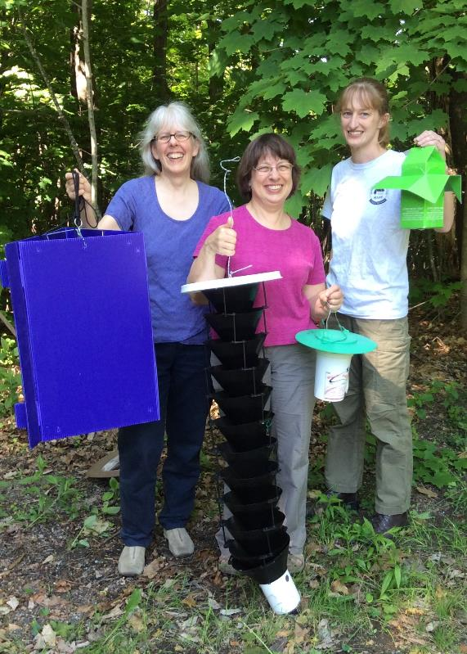
Maine Forest Insect Update
Allison Kanoti Maine Forest Service, DACF

Slide 2
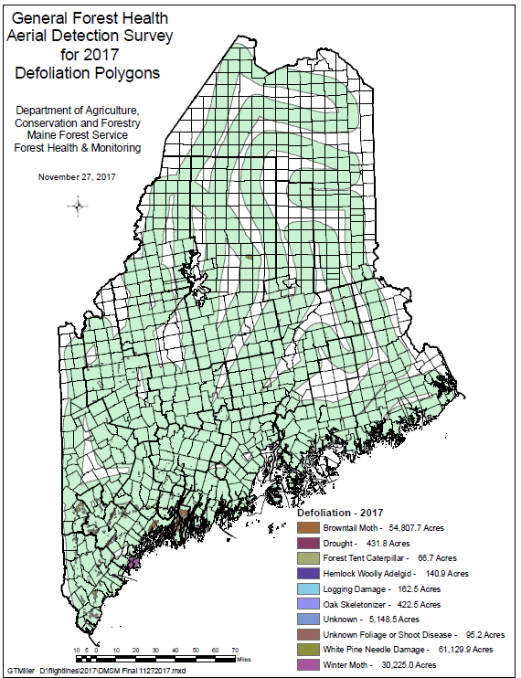
2017Aerial Survey
Damage Agents Acres Mapped
(2016 numbers in Parentheses)
WPND: ~61K (125K)
BTM: ~55K (62.6K)
WM: ~30K (6K)
Drought: ~430
BPOLR:~420 (3K)
HWA: 140
FTC: <70ac

Slide 3

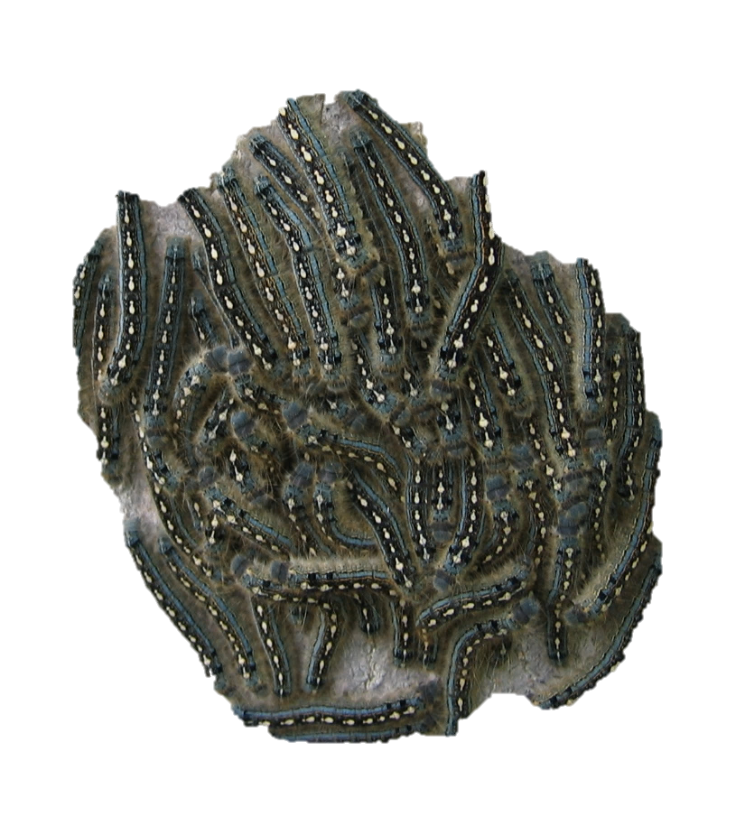
The Caterpillar Roundup
Spruce Budworm Update
Gypsy Moth Quarantine Expansion
Browntail Moth Explosion
Forest Tent Caterpillar Sightings

Slide 4
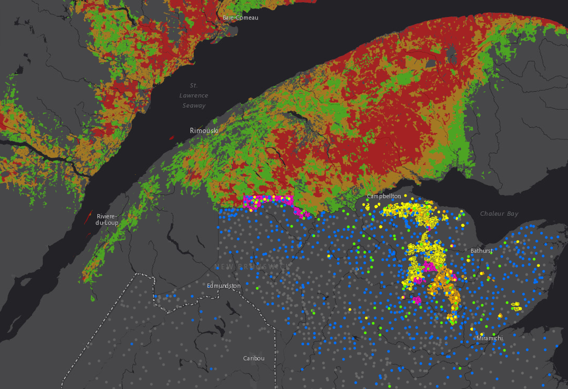
Spruce Budworm

Slide 5
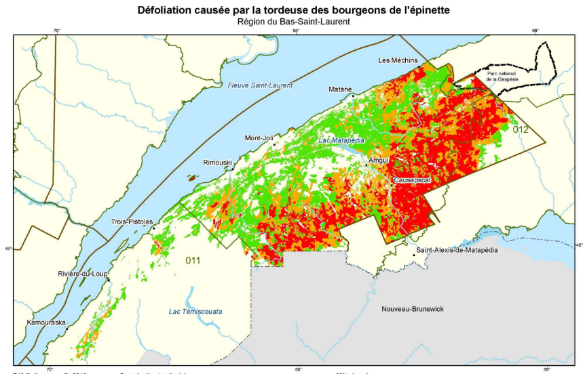
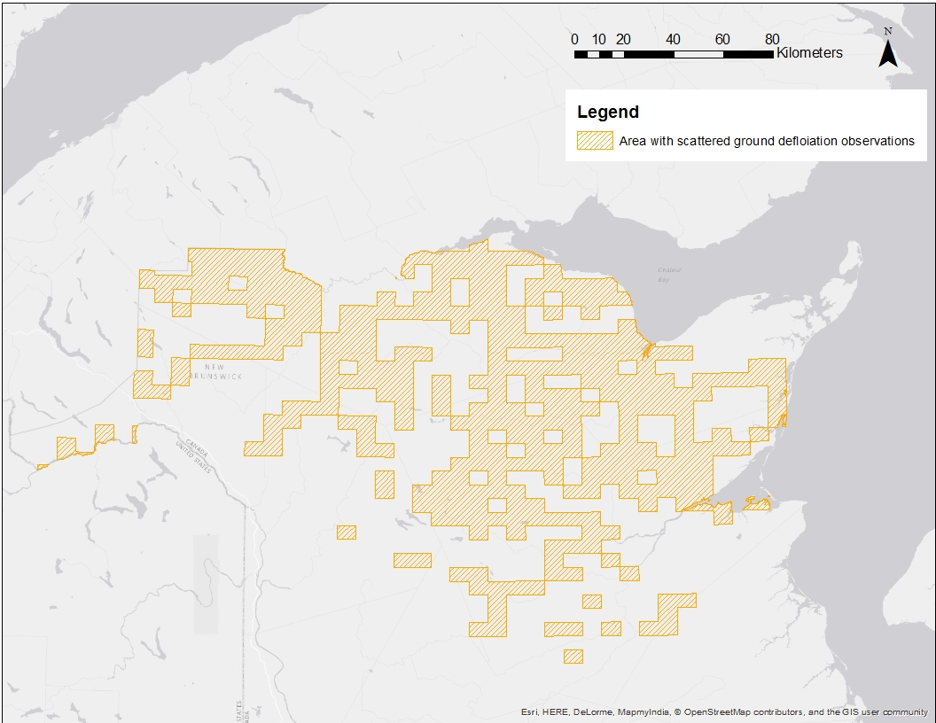
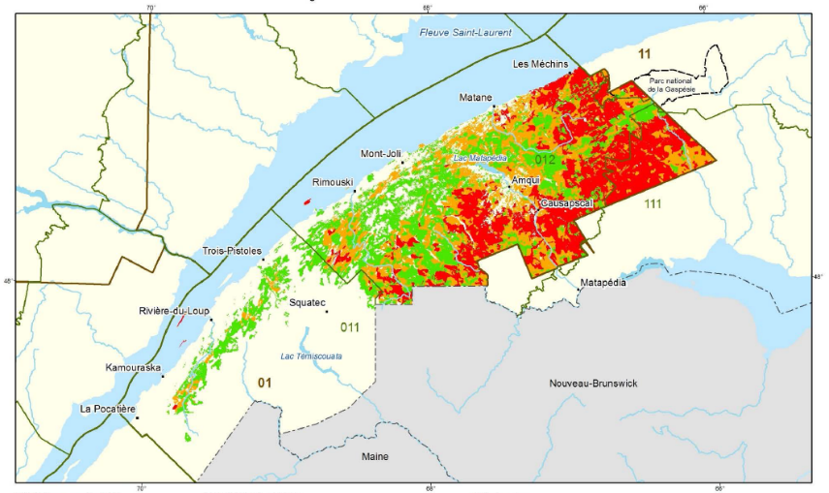
Notes:
Defoliation also increased and intensified in the Bas-Saint-Lawrence region.

Slide 6
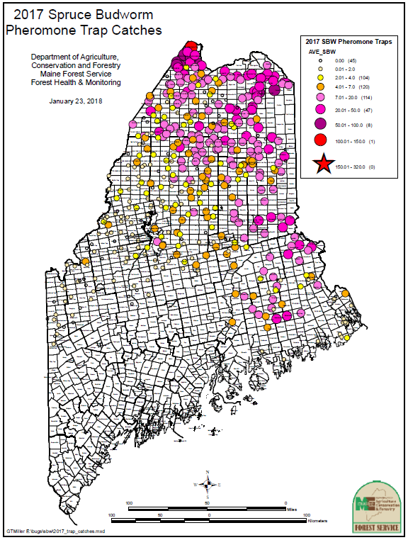
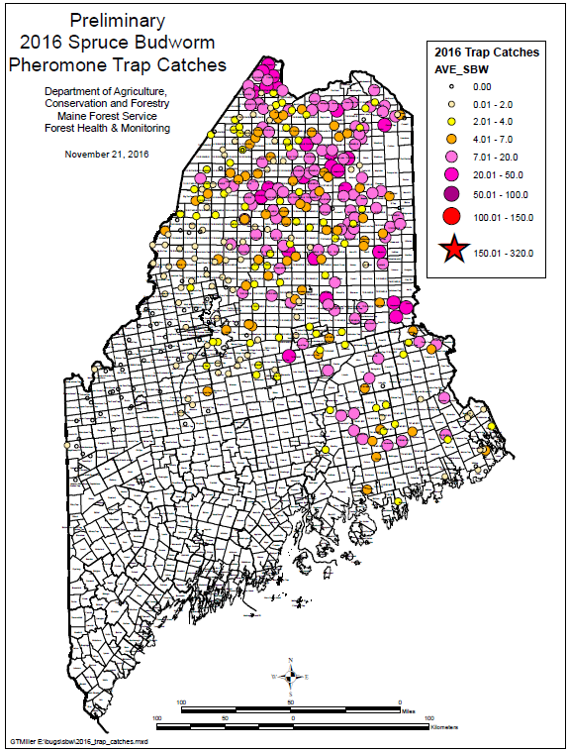
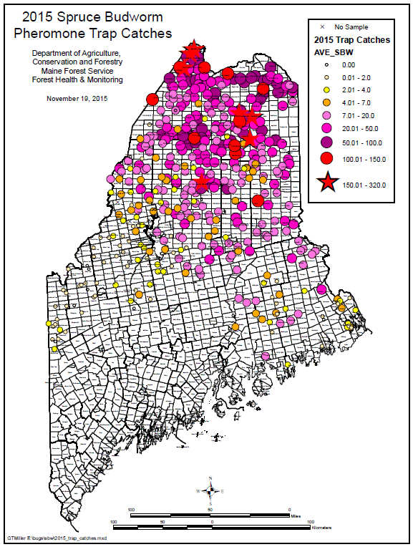

Slide 7
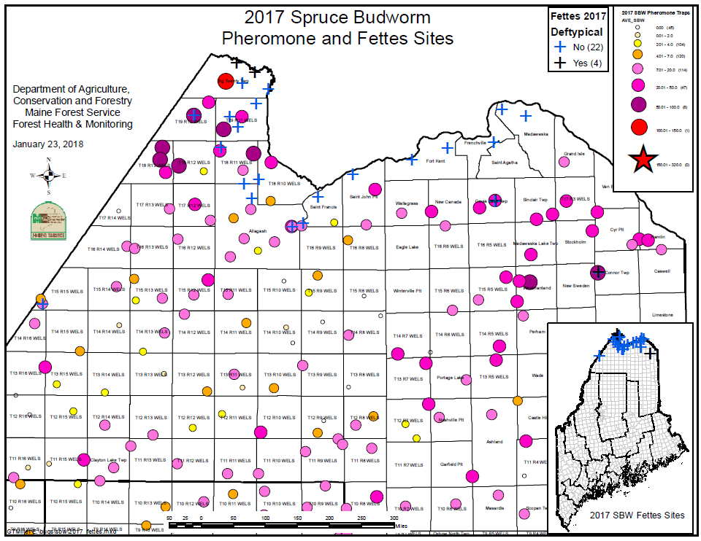
NB Trace-Light Defoliation
Fettes Method employed at Northern ME MFS L2 sites and other locations to quantify defoliation of current-year growth.
Trace defoliation at all sites (all causes)
Potential SBW-caused defoliation at 4 sites (2 in Big 20 Twp, 1 in Cross Lake Twp, 1 in Connor Twp)
Revisit of all sites and other sites with higher catches in July 2018

Slide 8
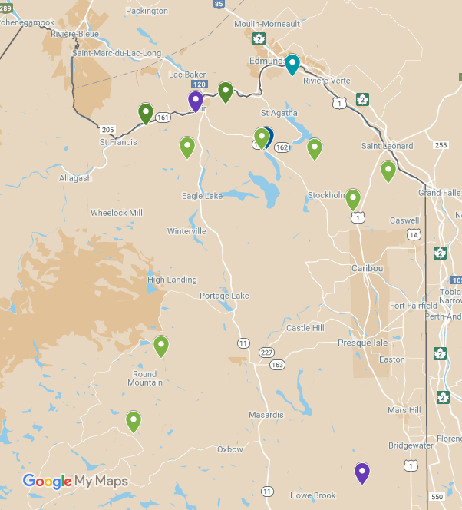
L2 Results -- 14 of 255 Sites Positive Max 2.3/30” Branch Total: 32

Slide 9
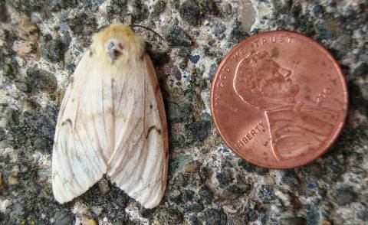
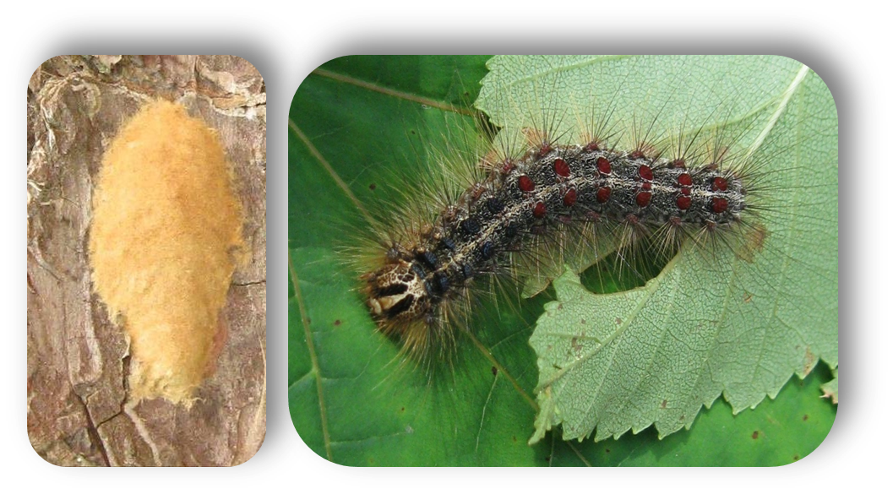
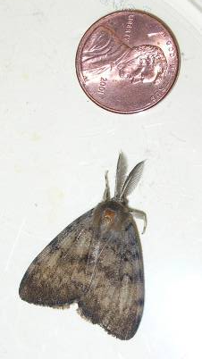
European Gypsy Moth
Outbreak Conditions in Southern NE
Still no Defoliation in ME (Feeding with FTC in Blue Hill)
One to watch for; especially with dry spring

Slide 10
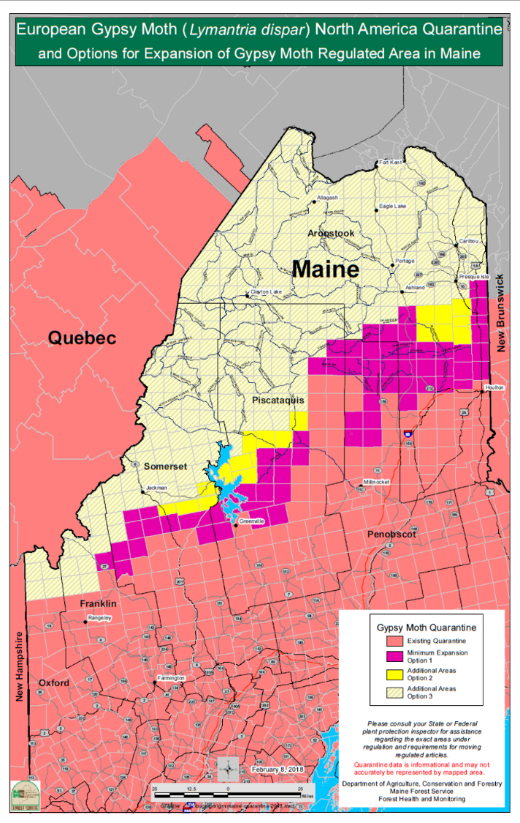
European Gypsy Moth
Not found in All of ME
Partial State Quarantine
Expansion Overdue
Letter sent requesting feedback
Rulemaking process will happen this year.
No expansion is not an option

Slide 11
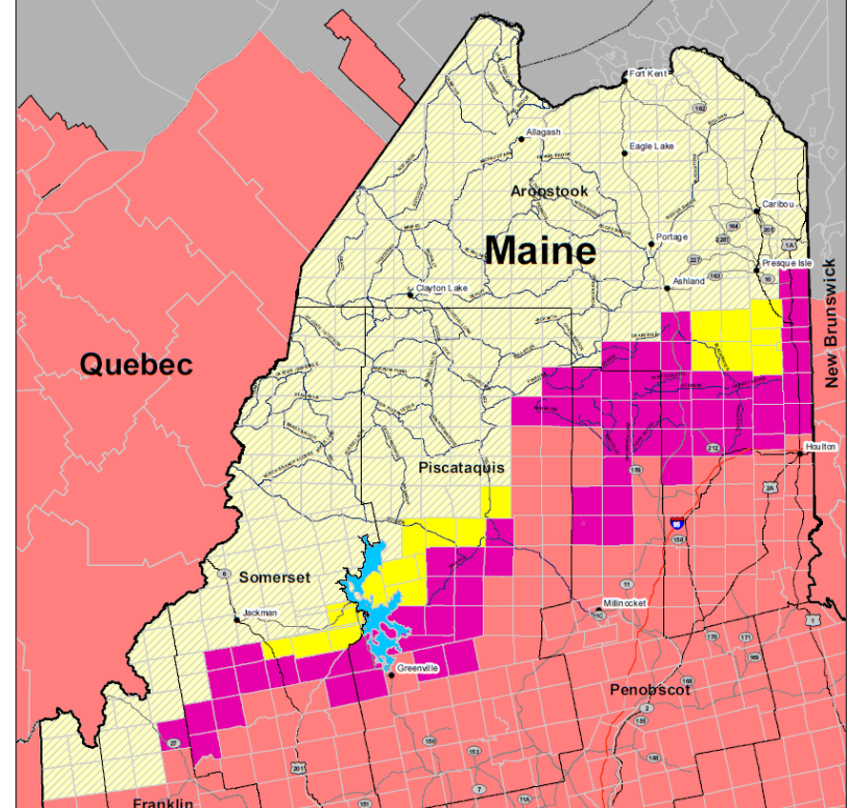
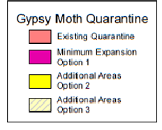

Slide 12
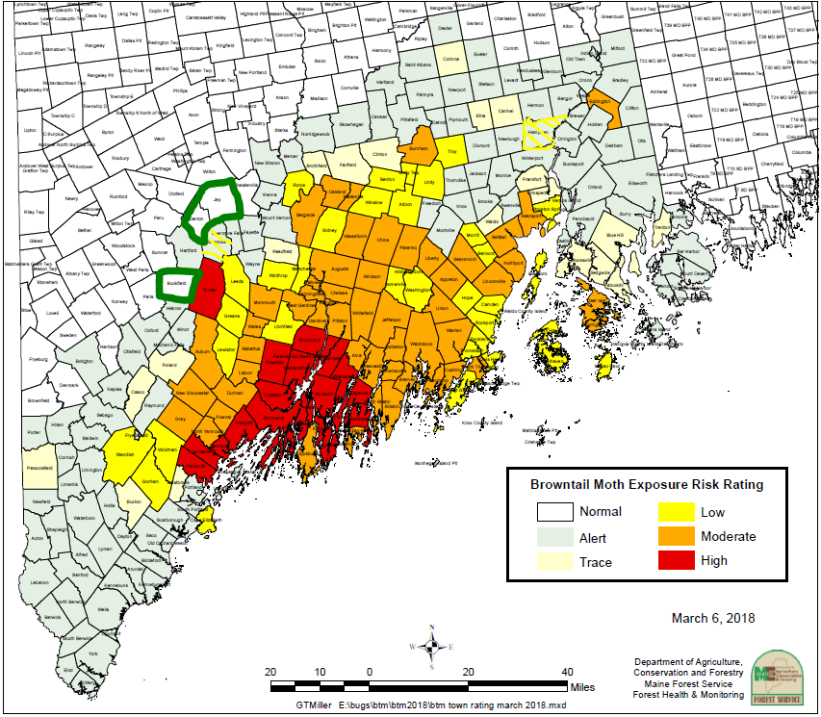
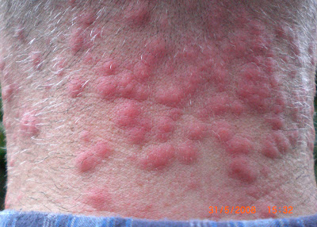
Browntail Moth
Heads up:
Bigger Footprint of: Web/Defoliation Detection
Adult Moth Detection
This one causes rash and other human health problems

Slide 13
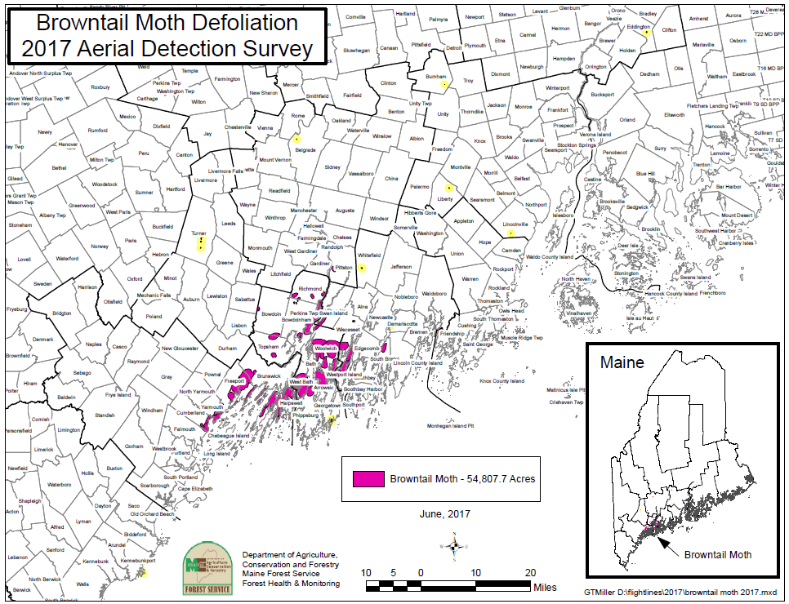
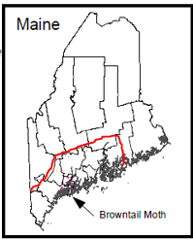
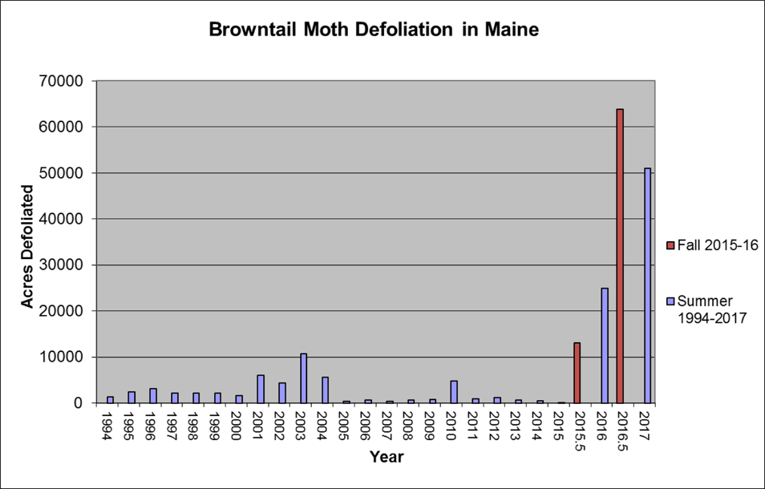

Slide 14
Browntail Moth Timeline

Slide 15
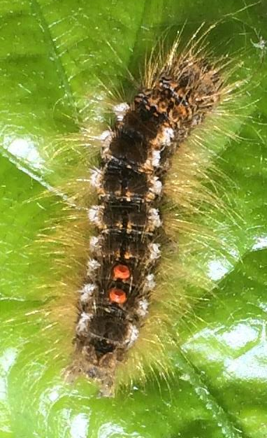
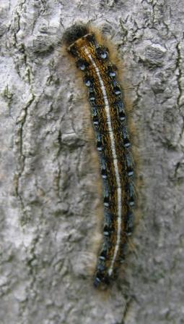
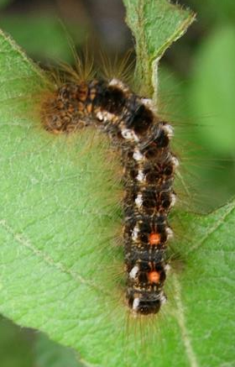
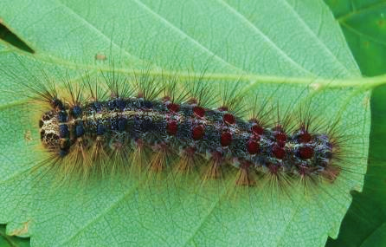
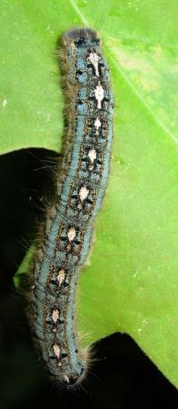
Tent-makers
No Tents
Browntail Moth | Eastern Tent | Forest Tent | Gypsy Moth
Look for Overall brown color; White tufts along sides; Red-orange dots on tail-end DANGER!! | Look for White stripe down center of back Blue spots like the “eye” in peacock feather along each side of stripe | Look for White or off-white footprint-shaped marks down the center of the back Blue body coloration in later instars | Look for Prominent knobs with hairs on each side of head capsule. Five pairs of blue- and six pairs of red- spots along back (4th instar and later).
Invasive Human & Forest Health Impacts | Native Mostly aesthetic impacts | Native Occasional outbreaks | Invasive Forest Health Impacts Quarantined pest
BEWARE of HAIRS
^
(microscopic)

Slide 16
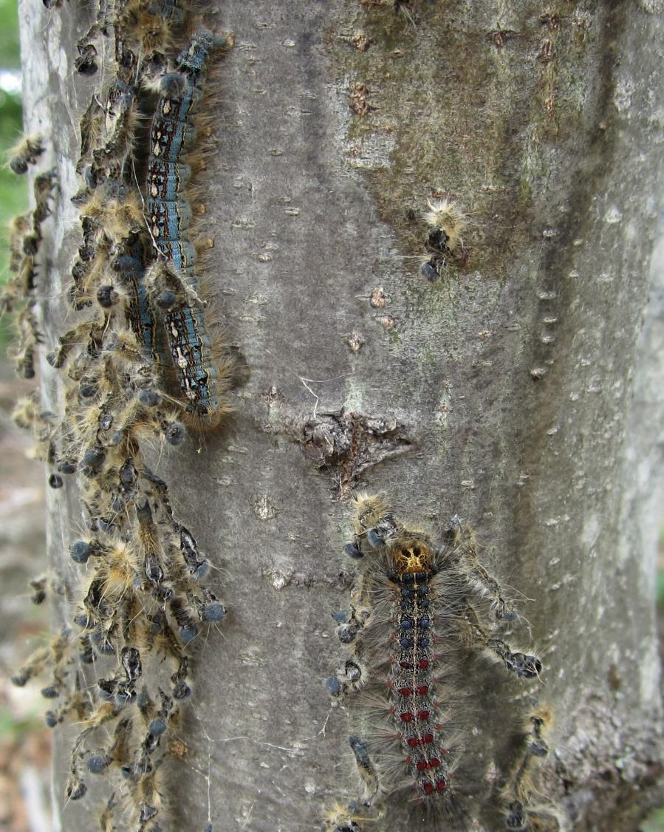
More Fuzzy Caterpillars
FOREST TENT
CATERPILLAR
Forest tent caterpillar
<70 ac
Oaks stripped in Blue Hill
Also Gypsy moth
Also BTM in area
Dry growing seasons could allow population growth
GYPSY MOTH
CATERPILLAR

Slide 17
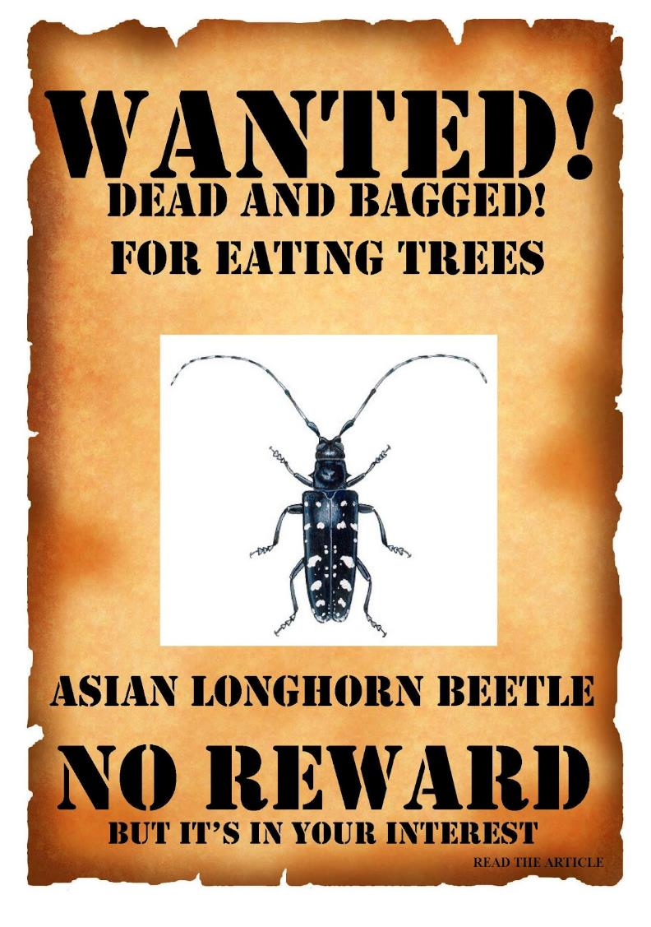
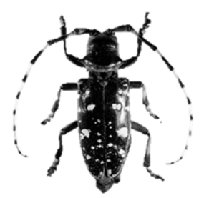
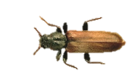

Invasive Beetle Update
Emerald Ash Borer
Asian Longhorned Beetle
Brown Spruce Longhorned Beetle

Slide 18
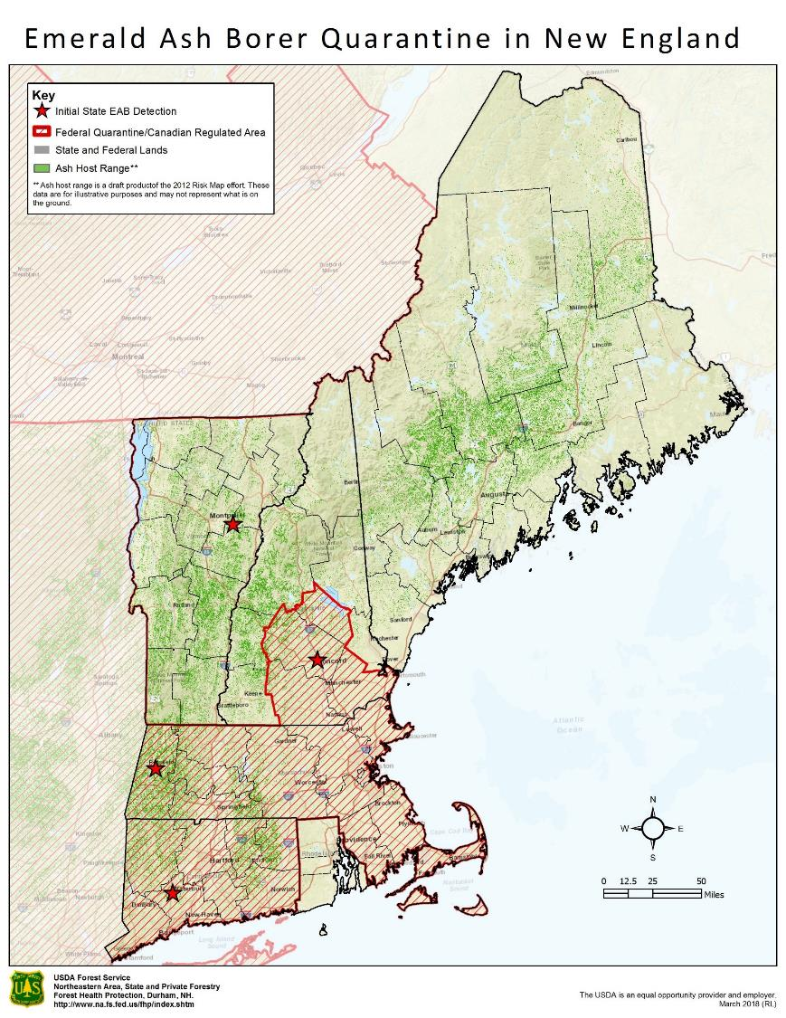
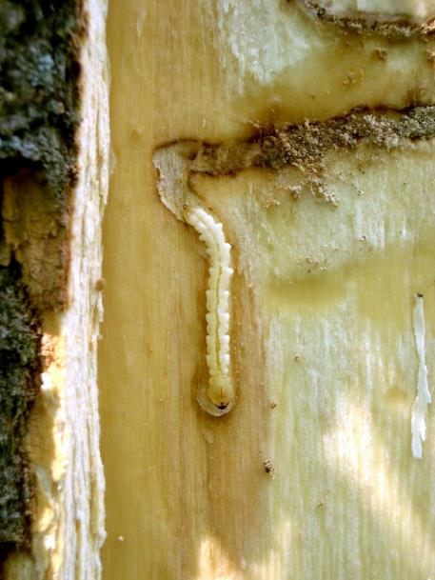
Emerald Ash Borer
Not found in Maine (Yet)
Recent Detection in VT
Quarantine Expansion in QC
2018 Trap Surveys (~650) by Delta 21 (USDA Contractor) in SW ME and MFS in rest of state

Slide 19
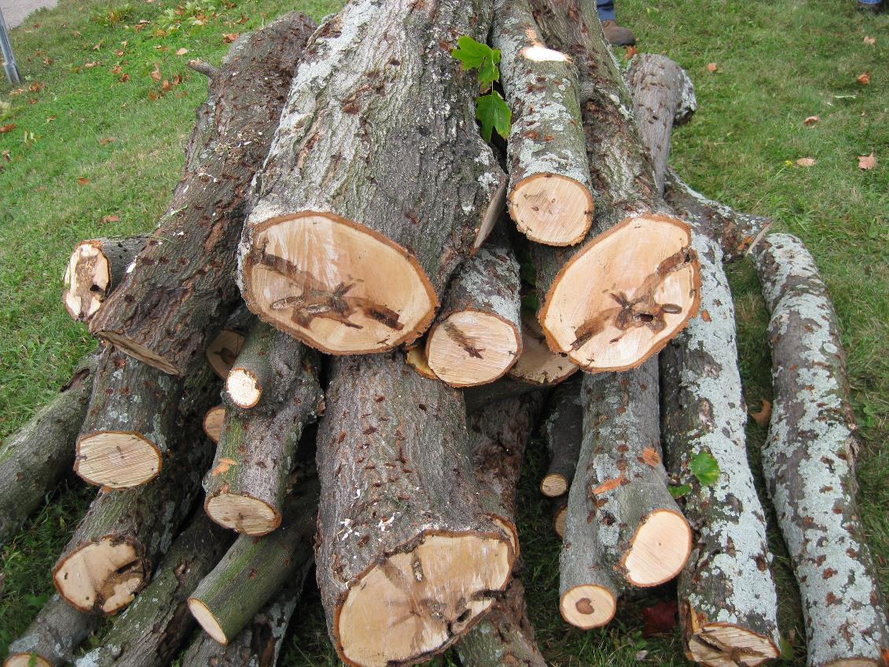
Asian Longhorned Beetle
Eradicated from Chicago, Boston, NJ and Soon Queens/Brooklyn?
Not found in Maine
Out of state firewood still being brought upta camp
Bugs stow away in firewood
Photo: Patricia Douglass, USDA APHIS-PPQ

Slide 20
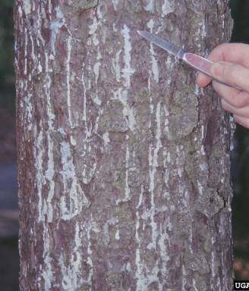
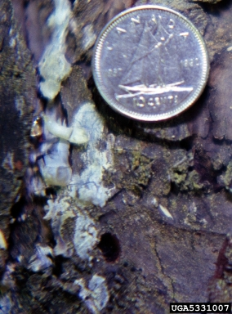
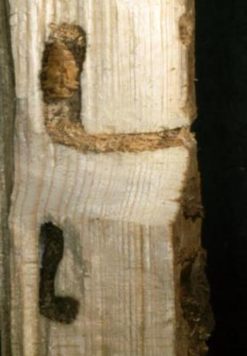
Brown Spruce Longhorned Beetle
Throughout much of Nova Scotia
Established in Memramcook, NB
Not found outside of restricted area
Photos (L-R):
Stanislaw Kinelski, Bugwood.org,
Jon Sweeney, bugwood.org (Center,Right)

Slide 21
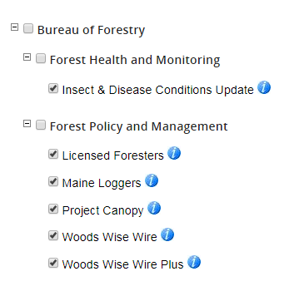




UPDATES
www.maine.gov/dacf

